Slide 1
The role of plastics in climate change - presentation
William So
Notes:
Hello. I am William So and my student ID is 20703125. Today, I am going to talk about the role of plastics in climate change. I will be presenting the findings from my research and suggesting actions to take based on them.

Slide 2
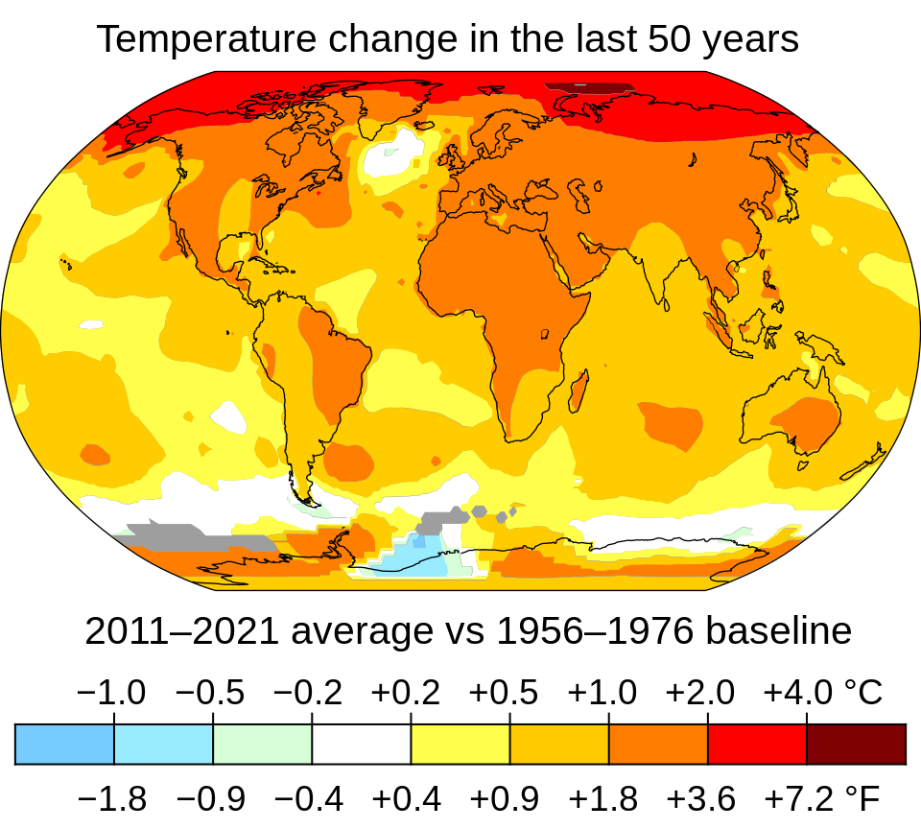
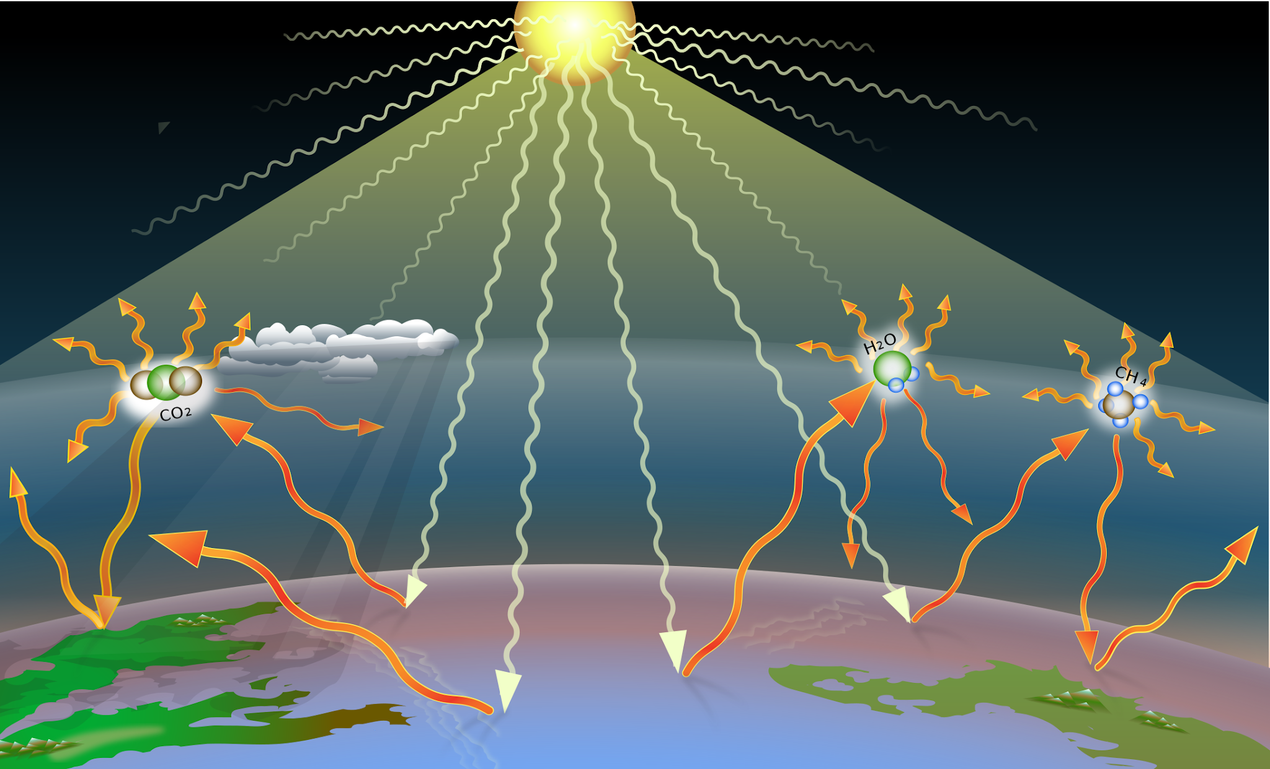
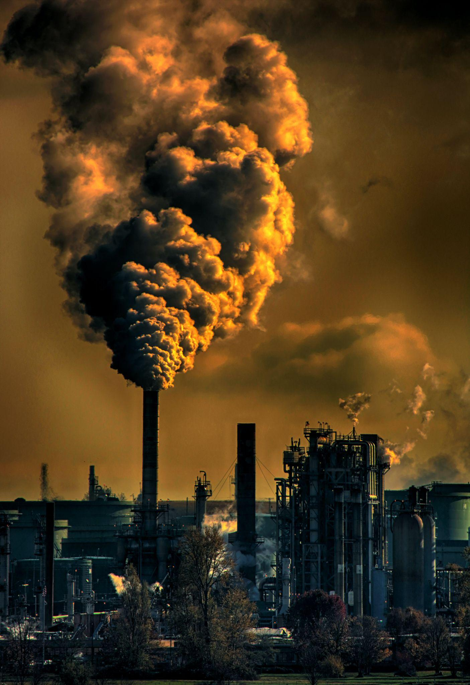
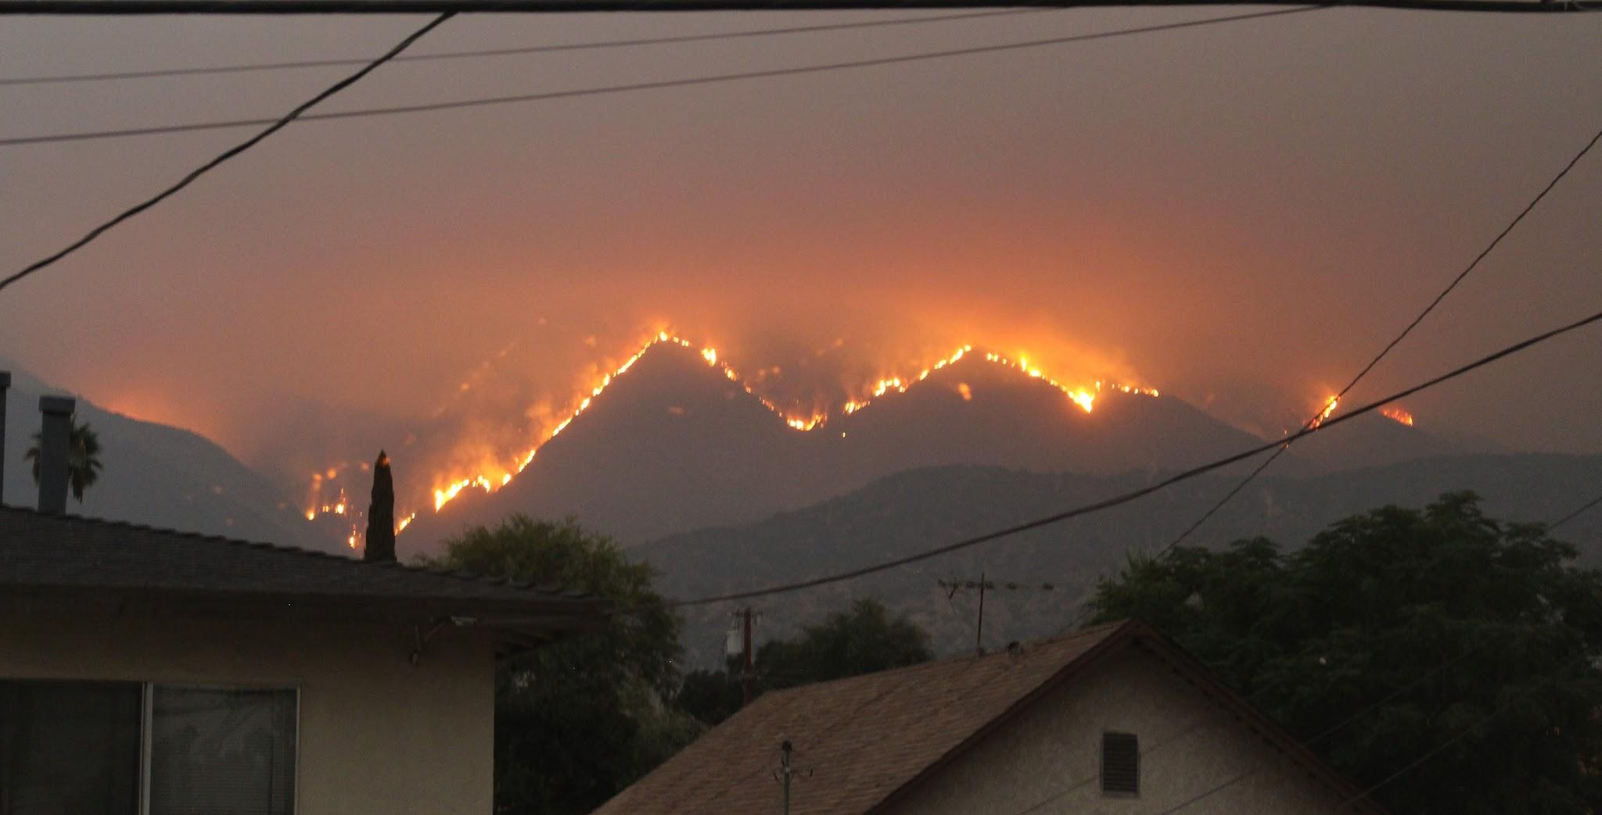
What is climate change?
NASA’s Scientific Visualization Studio, Key and Title by uploader (Eric Fisk), CC BY-SA 4.0, via Wikimedia Commons
1.2 °C
A loose necktie, CC BY-SA 4.0, via Wikimedia Commons
(Arias et al., 2021)
Photo by Chris LeBoutillier: https://www.pexels.com/photo/photography-of-factory-929385/
NASA’s Scientific Visualization Studio, Key and Title by uploader (Eric Fisk), CC BY-SA 4.0, via Wikimedia Commons
Notes:
But before we dive into the results, it’s good for us to know about the background. What is climate change? It can refer to the long-term and short-term changes to Earth’s climate, but here we are using the common usage: global warming. It involves the emission of greenhouse gases from industrial activities, and those gases are heat-trapping, enhancing the greenhouse effect. As a result, most of Earth becomes warmer. Currently, the temperature rise has reached 1.2 °C compared to pre-industrial period, and this seemingly small rise actually causes significantly more extreme weather conditions, which is why people are thinking of ways to prevent it from rising any further. So that's an overview of climate change.

Slide 3
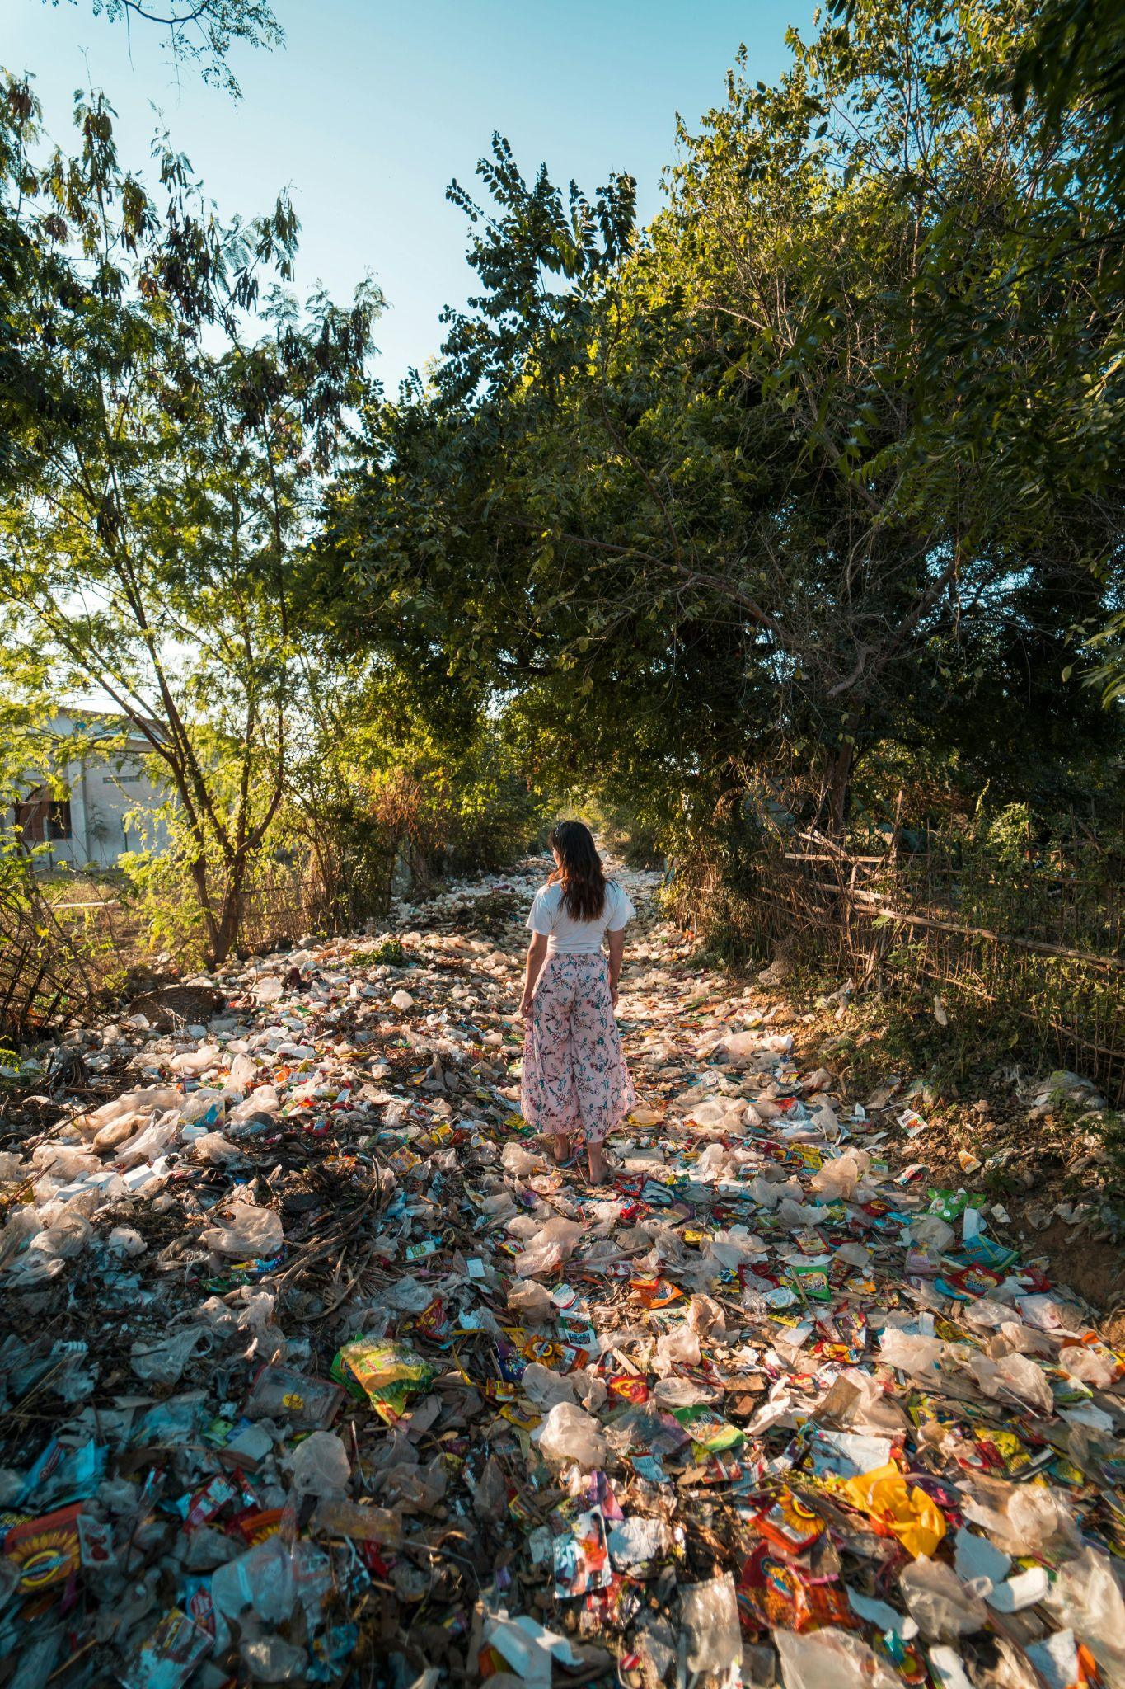
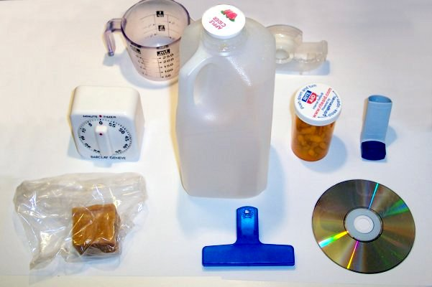
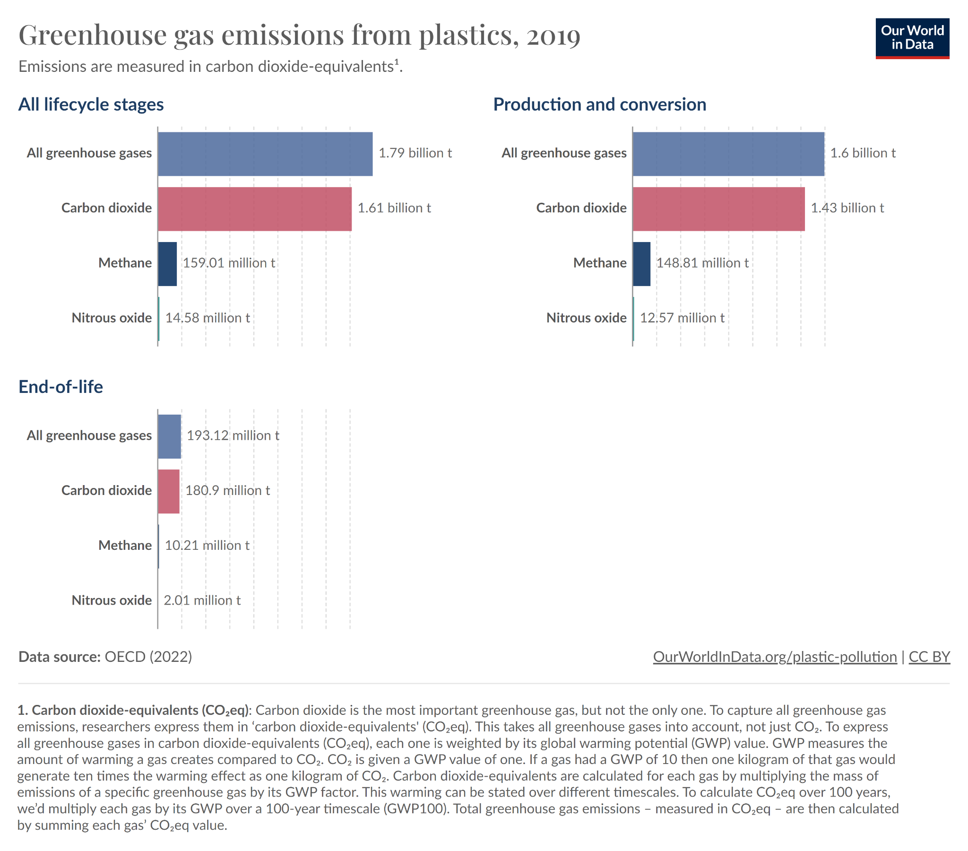

What is plastic overuse?
ImGz, CC BY-SA 3.0, via Wikimedia Commons
Photo by Stijn Dijkstra: https://www.pexels.com/photo/photo-of-a-woman-standing-on-a-pile-of-garbage-near-trees-2583835/
Notes:
Next up, we have plastic overuse. Plastics come in many forms and are versatile materials, making them widely used. Yet, plastics are usually non-biodegradable, and it is more convenient to dispose of them by leaving them in the nature. As a result, plastic waste accumulate in the environment, bringing harm to ecosystems and health. However, in this presentation, I want to focus on an frequently overlooked aspect of plastic overuse: greenhouse gas emission. As I have said in the previous slide, greenhouse gas is linked to climate change, and so this link is what I will be showing today.

Slide 4
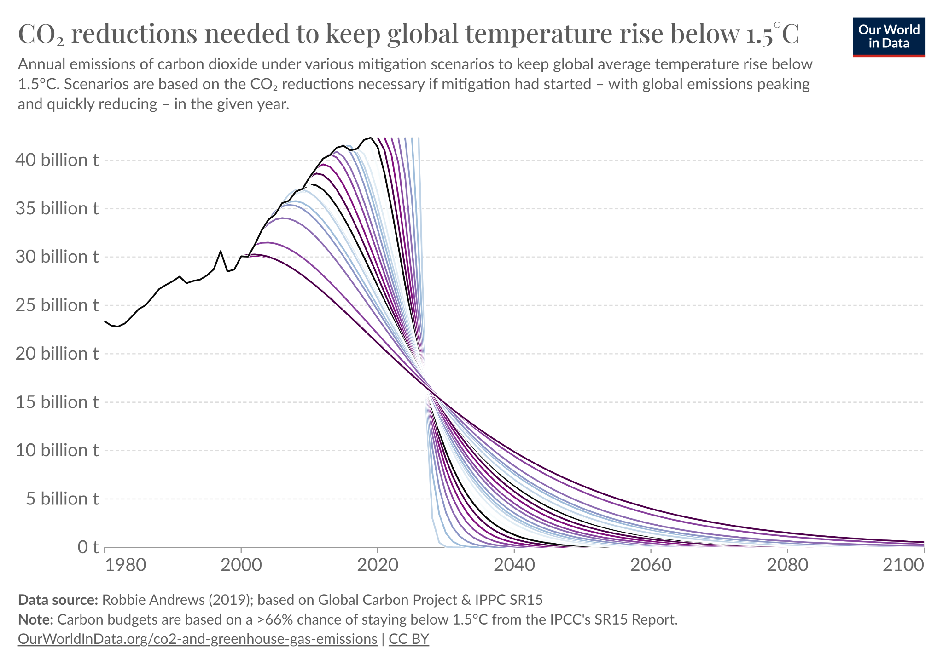
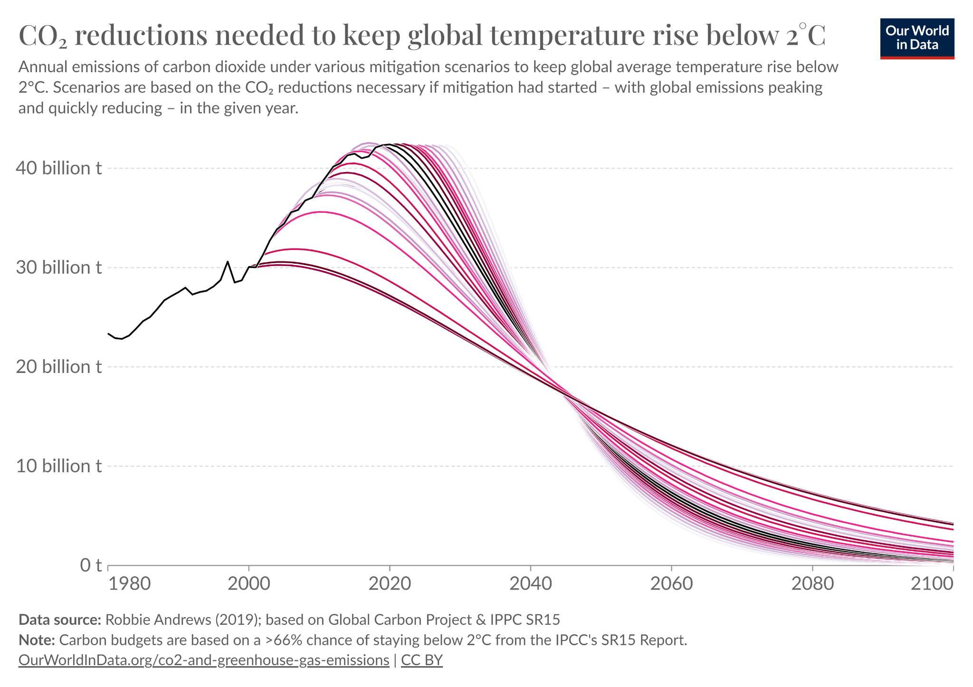
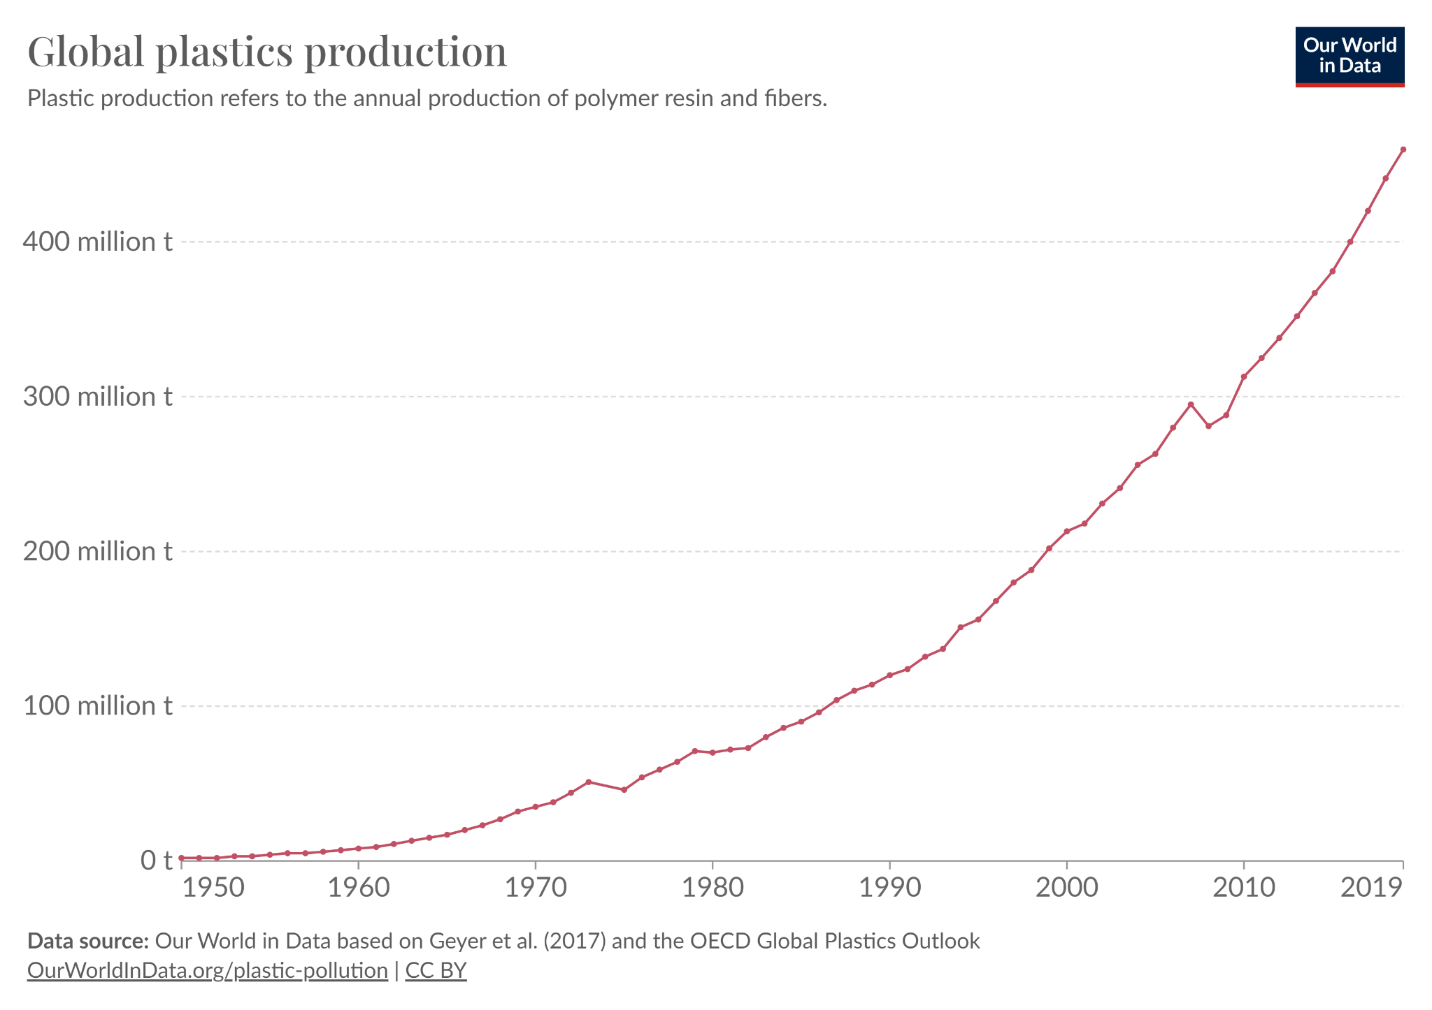
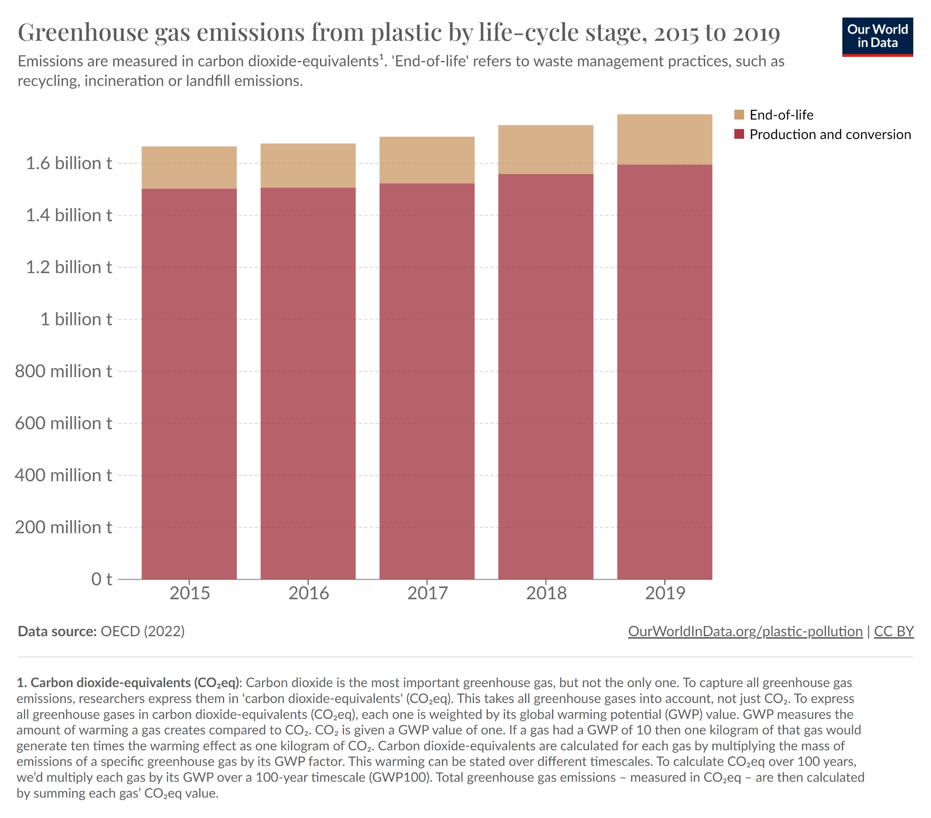
Datasets
Our World in Data, a scientific online publication focusing on global issues using data
CO₂ reductions needed to keep global temperature rise below 1.5 °C
CO₂ reductions needed to keep global temperature rise below 2 °C
Global plastics production
Greenhouse gas emissions from plastic by life-cycle stage, 2015 to 2019
Not all data are used
Up to dated to 2019
Notes:
In this report, we analyzed four datasets from Our World in Data, a scientific online publication focusing on global issues by publishing data infographics. The datasets are CO₂ reductions needed to keep global temperature rise below 1.5 °C and 2 °C, global plastics production, and greenhouse gas emissions from plastic. For our research, only some data from each dataset are used. In particular, for CO₂ reduction scenarios, only the “starting in 2019” scenario is used. For GHG emission by lifecycle stage, only the production and conversion data is used. All data are only up to dated to 2019.

Slide 5
Results
Notes:
After analyzing the data, we found five insights related to the link between climate change and plastics. I am going to share three most important ones here, and the findings are not great for our planet Earth.

Slide 6
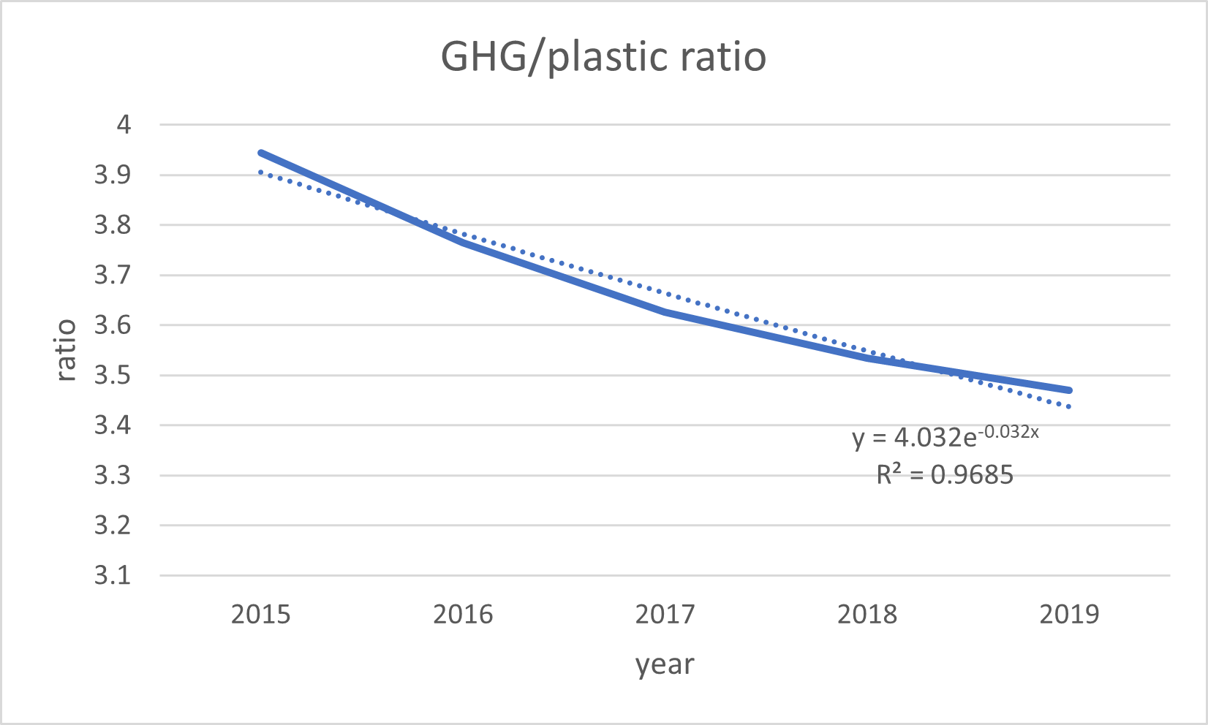
Good news first
Notes:
Let’s have the good news first. If you compare the global plastic production and plastic greenhouse gas emission in between 2015 and 2019, you will find that the GHG emission from plastic has grown only slightly despite the global plastics production growing rapidly. So we decided to calculate the amount of GHG generated per plastic produced, and here are the results. As you can see, there is a significant decrease of the ratio from about 3.95 in 2015 to 3.48 in 2019, a 11.9% decrease in only four years! What this shows is that the industrial processes has improved. We expect these gains to continue into the future, albeit with diminishing returns. So what does this mean for the GHG emission from plastics in the future?

Slide 7
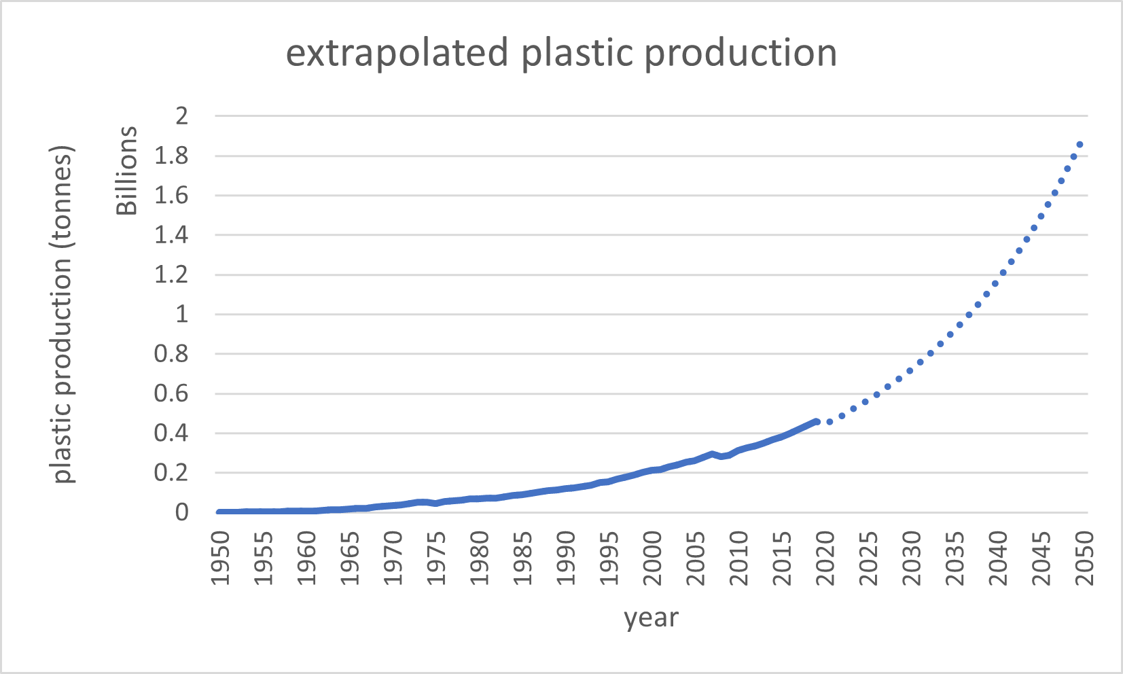
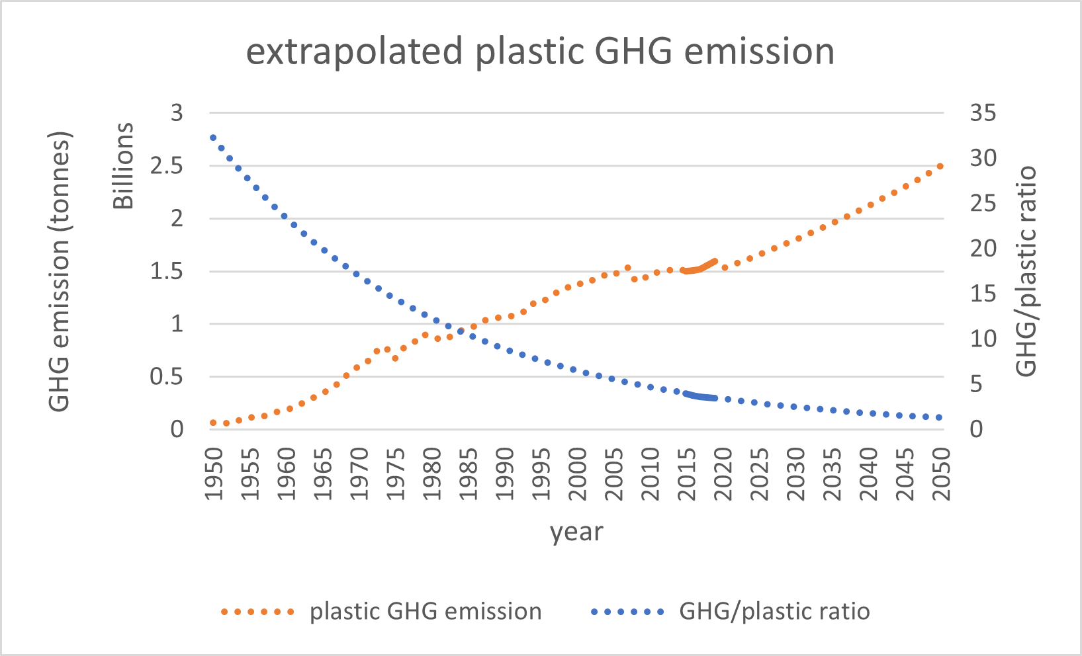
Future plastic GHG emission
Notes:
Unfortunately, the improvements in industry processes cannot catch up with the increase in plastic production. Assuming current policies continue, plastic GHG emission will still continue to increase, albeit linearly. Plastic production created 1.60 billion tonnes of GHG emission in 2019, and is expected to increase by 56.3% to 2.60 billion tonnes in 2050. This can be explained by the exponential growth of plastic production. What this insight shows is that plastic reduction is required if we want to decrease the GHG emission from plastics. Efficiency gains in processes cannot reduce the emission alone. This pains a pessimistic outlook for the next slide…

Slide 8
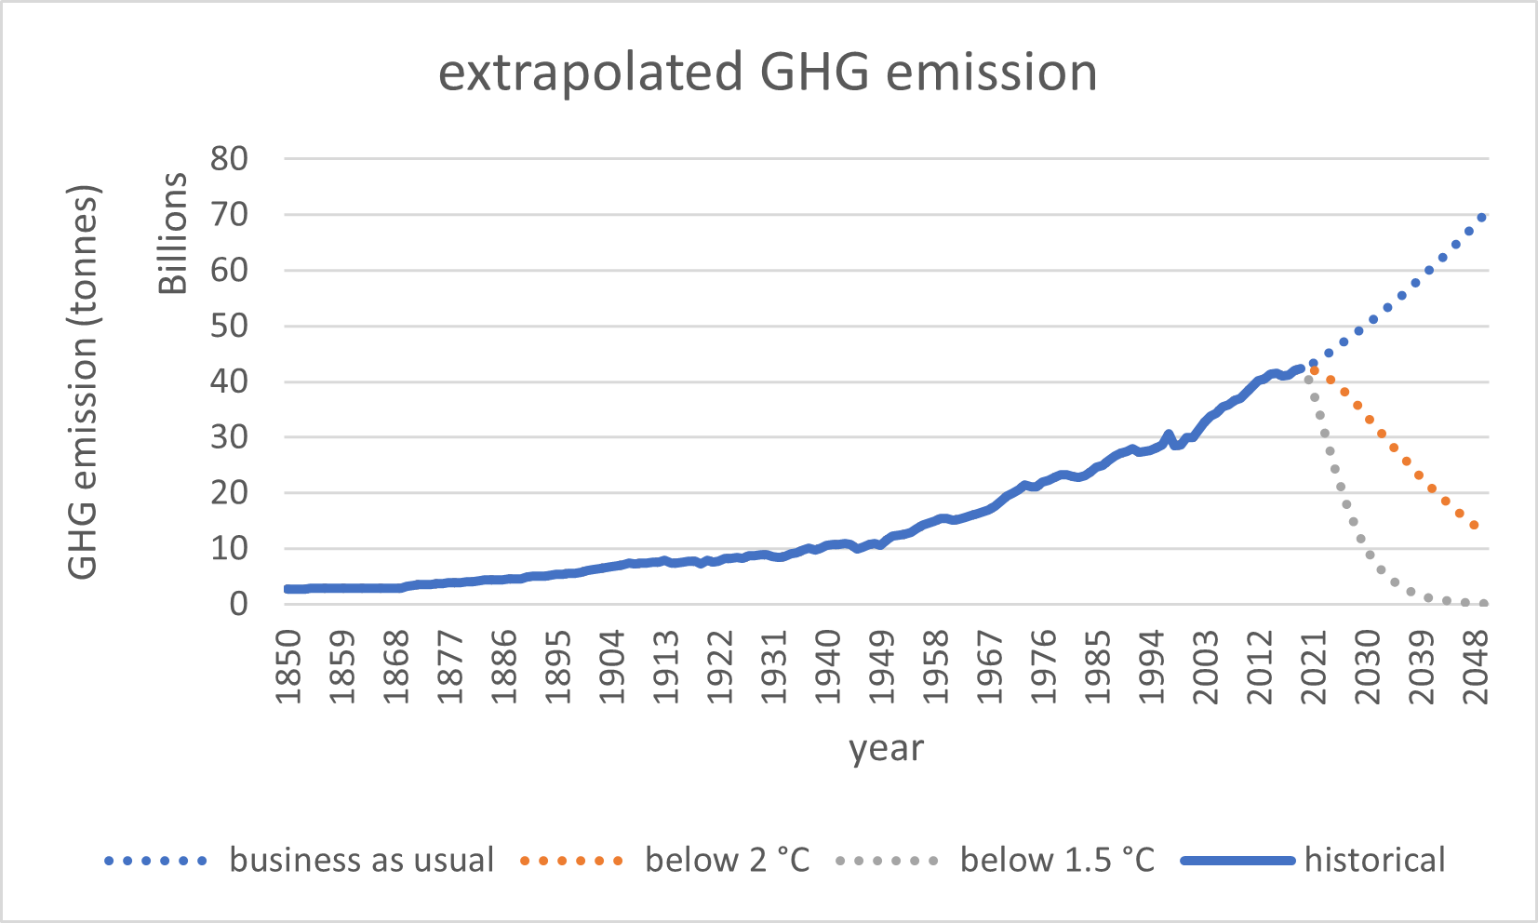
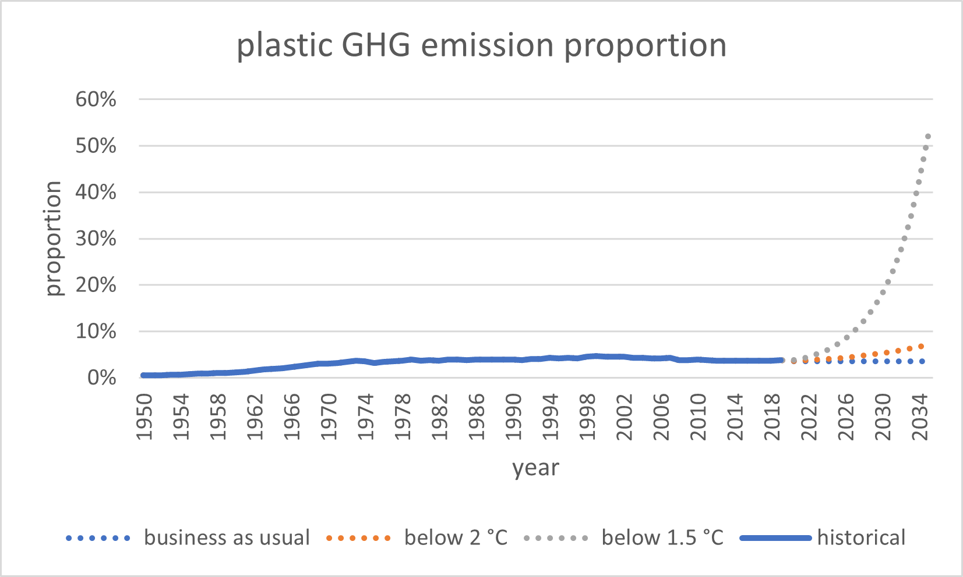
Pessimistic outlook
Notes:
We want to see the contribution of GHG emission from plastic to the total emission. To do so, first we obtain the total GHG emission for three scenarios: business as usual, limiting global temperature rise to below 2 °C, and below 1.5 °C, as shown on the slide right now. The reduction scenarios assume emission reduction starts in 2019. Compared to business as usual, the reduction required the in below 2 °C and 1.5 °C scenario are drastic. Now, we can find out the contribution of GHG emission from plastic, assuming current policies continue. As seen in the new graph, for business as usual, the contribution hovers around 3.5%. But for the limit scenarios, the proportion increases significantly. For 1.5 °C, the percentage increases from 3.8% in 2019 to 7.1% in 2035, while for 2 °C, it reaches 52.7% by 2035. This shows that any action limiting global temperature rise must also involve reducing GHG emission from plastic. As concluded in the previous slide, this requires reducing plastic production.

Slide 9
Conclusion
Plastic production processes are improving to reduce GHG emission per produced plastic
Plastic reduction is required to reduce GHG emission from plastics
Limiting global temperature rise requires plastic reduction
Continue to improve plastic production processes
Reduce incentives to use plastic as to reduce its demand and thus production
Policymakers should not overlook plastic overuse when considering climate change
Any easy-to-implement solutions
Notes:
To sum up, we have three conclusions. First, plastic production processes are improving to reduce GHG emission per produced plastic. However, it is insufficient to decrease the GHG emission because the plastic production will increase too quickly, so plastic reduction is required to reduce GHG emission from plastics. Lastly, by comparing different GHG reduction scenarios, we found that GHG emission from plastic will significantly contribute to GHG emission in reduction scenarios, so limiting global temperature rise requires plastic reduction. In response to these, we propose the following three suggestions: continue to improve plastic production processes, reduce incentives to use plastic as to reduce its demand and thus production, and policymakers should not overlook plastic overuse when considering climate change. However, we recognize the difficulties in implementing said suggestions, so any easier solution is very much preferred.

Slide 10
Thank you
All data and supplementary materials are available on Google Drive: https://drive.google.com/file/d/1zUfvTzmn7bZjU4F_masS_pfS1n0YQ6jm/view?usp=sharing
Notes:
That is the presentation for today. You can find all data and supplementary materials used in the link shown on the screen right now. All image credits are below or inside the image.

Slide 11
Bibliography
Arias, P. A., Bellouin, N., Coppola, E., Jones, R. G., Krinner, G., Marotzke, J., ... & Zickfeld, K. (2021). Technical Summary. Climate Change 2021: The Physical Science Basis. Contribution of Working Group I to the Sixth Assessment Report of the Intergovernmental Panel on Climate Change. https://doi.org/10.1017/9781009157896.002
Ritchie, H., Roser, M., & Rosado, P. (2020). CO₂ and Greenhouse Gas Emissions. Our World in Data. https://ourworldindata.org/co2-and-greenhouse-gas-emissions [Online Resource]
Ritchie, H., Samborska, V., & Roser, M. (2023). Plastic Pollution. Our World in Data. https://ourworldindata.org/plastic-pollution [Online Resource]
Notes:
And here’s the list of references I have used throughout the presentation. Thank you for listening.

